Slide 1
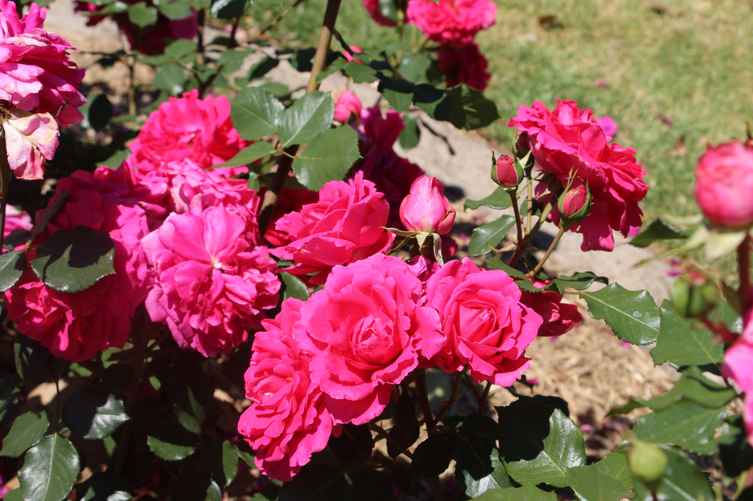
Why Roses? Sue Keays

Slide 2
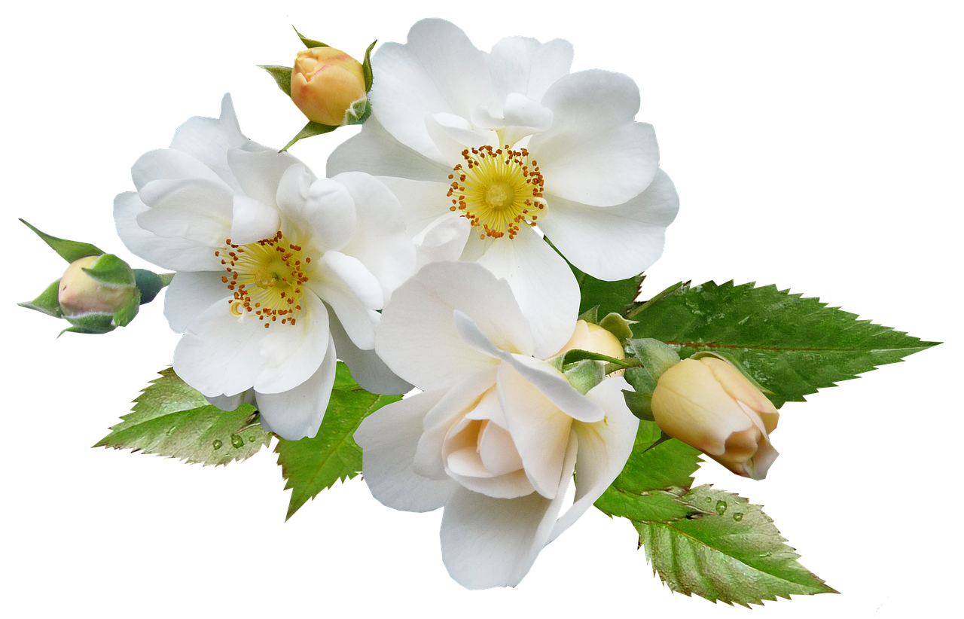
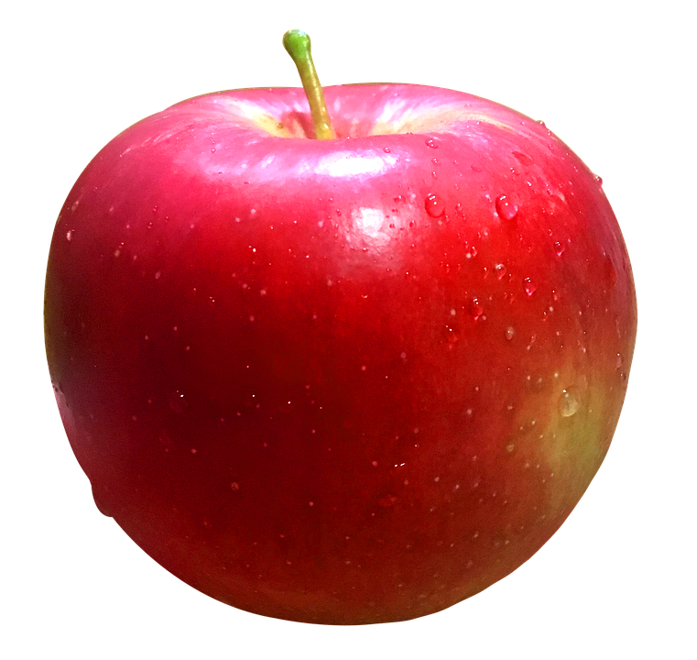
The Rosaceae or Rose Family
Includes edible fruits, such as apples, pears, quinces, apricots, plums, cherries peaches, apples, pears, quinces, apricots, plums, cherries, peaches, raspberries, black berries, loquats, rose hips, strawberries, hawthorns and almonds.

Slide 3
Evolution of the Rose: Species Roses to Most Popular Flower in History
ANCIENT ORIGINS – fossilised remains 22 million to 35,000 million yrs BP (Colorado). Scientists believe the climate was then largely temperate with plentiful insect life - conditions favoured by roses today.
Found only in NORTHERN HEMISPHERE, including Europe, Asia, Western North America – None IN SOUTHERN HEMISPHERE.
Buried with Mummies in Egypt, Roman aristocrats bathed in rose petals, Vikings used hips as source of food (rich in Vit.C ).
In religion: symbol of human soul for Muslims, metaphor for human soul for Judaism, some think thorns in Christ’s Crown of Thorns were prickly rose thorns.
Rose oil & rose water highly valued in cosmetics eg Jurlique cosmetics and perfumes.
C15 War of the Roses: White Rose of York v Red Rose of Lancaster (Henry VII)
Features in art of Asia, India, Persia, Europe and Britain.

Slide 4
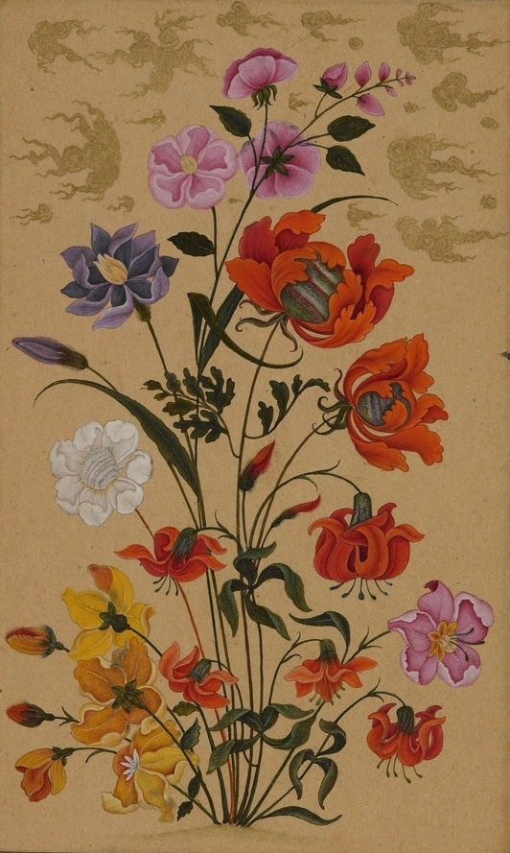
Depictions of the Rose in Mughal & Persian Islamic Art (below)
(Pinterest free pics https://www.bing.com/search?q=free+puictures+rose+in+mughal+art&gs)

Slide 5
STEP I: Know Your Roses
Origins - Species Roses.
Heritage Roses
Old Fashioned Roses
Polyanthas
Climbing Roses
Modern Roses
Hybrid Teas
Floribundas
Novelty roses
Miniature
Others

Slide 6
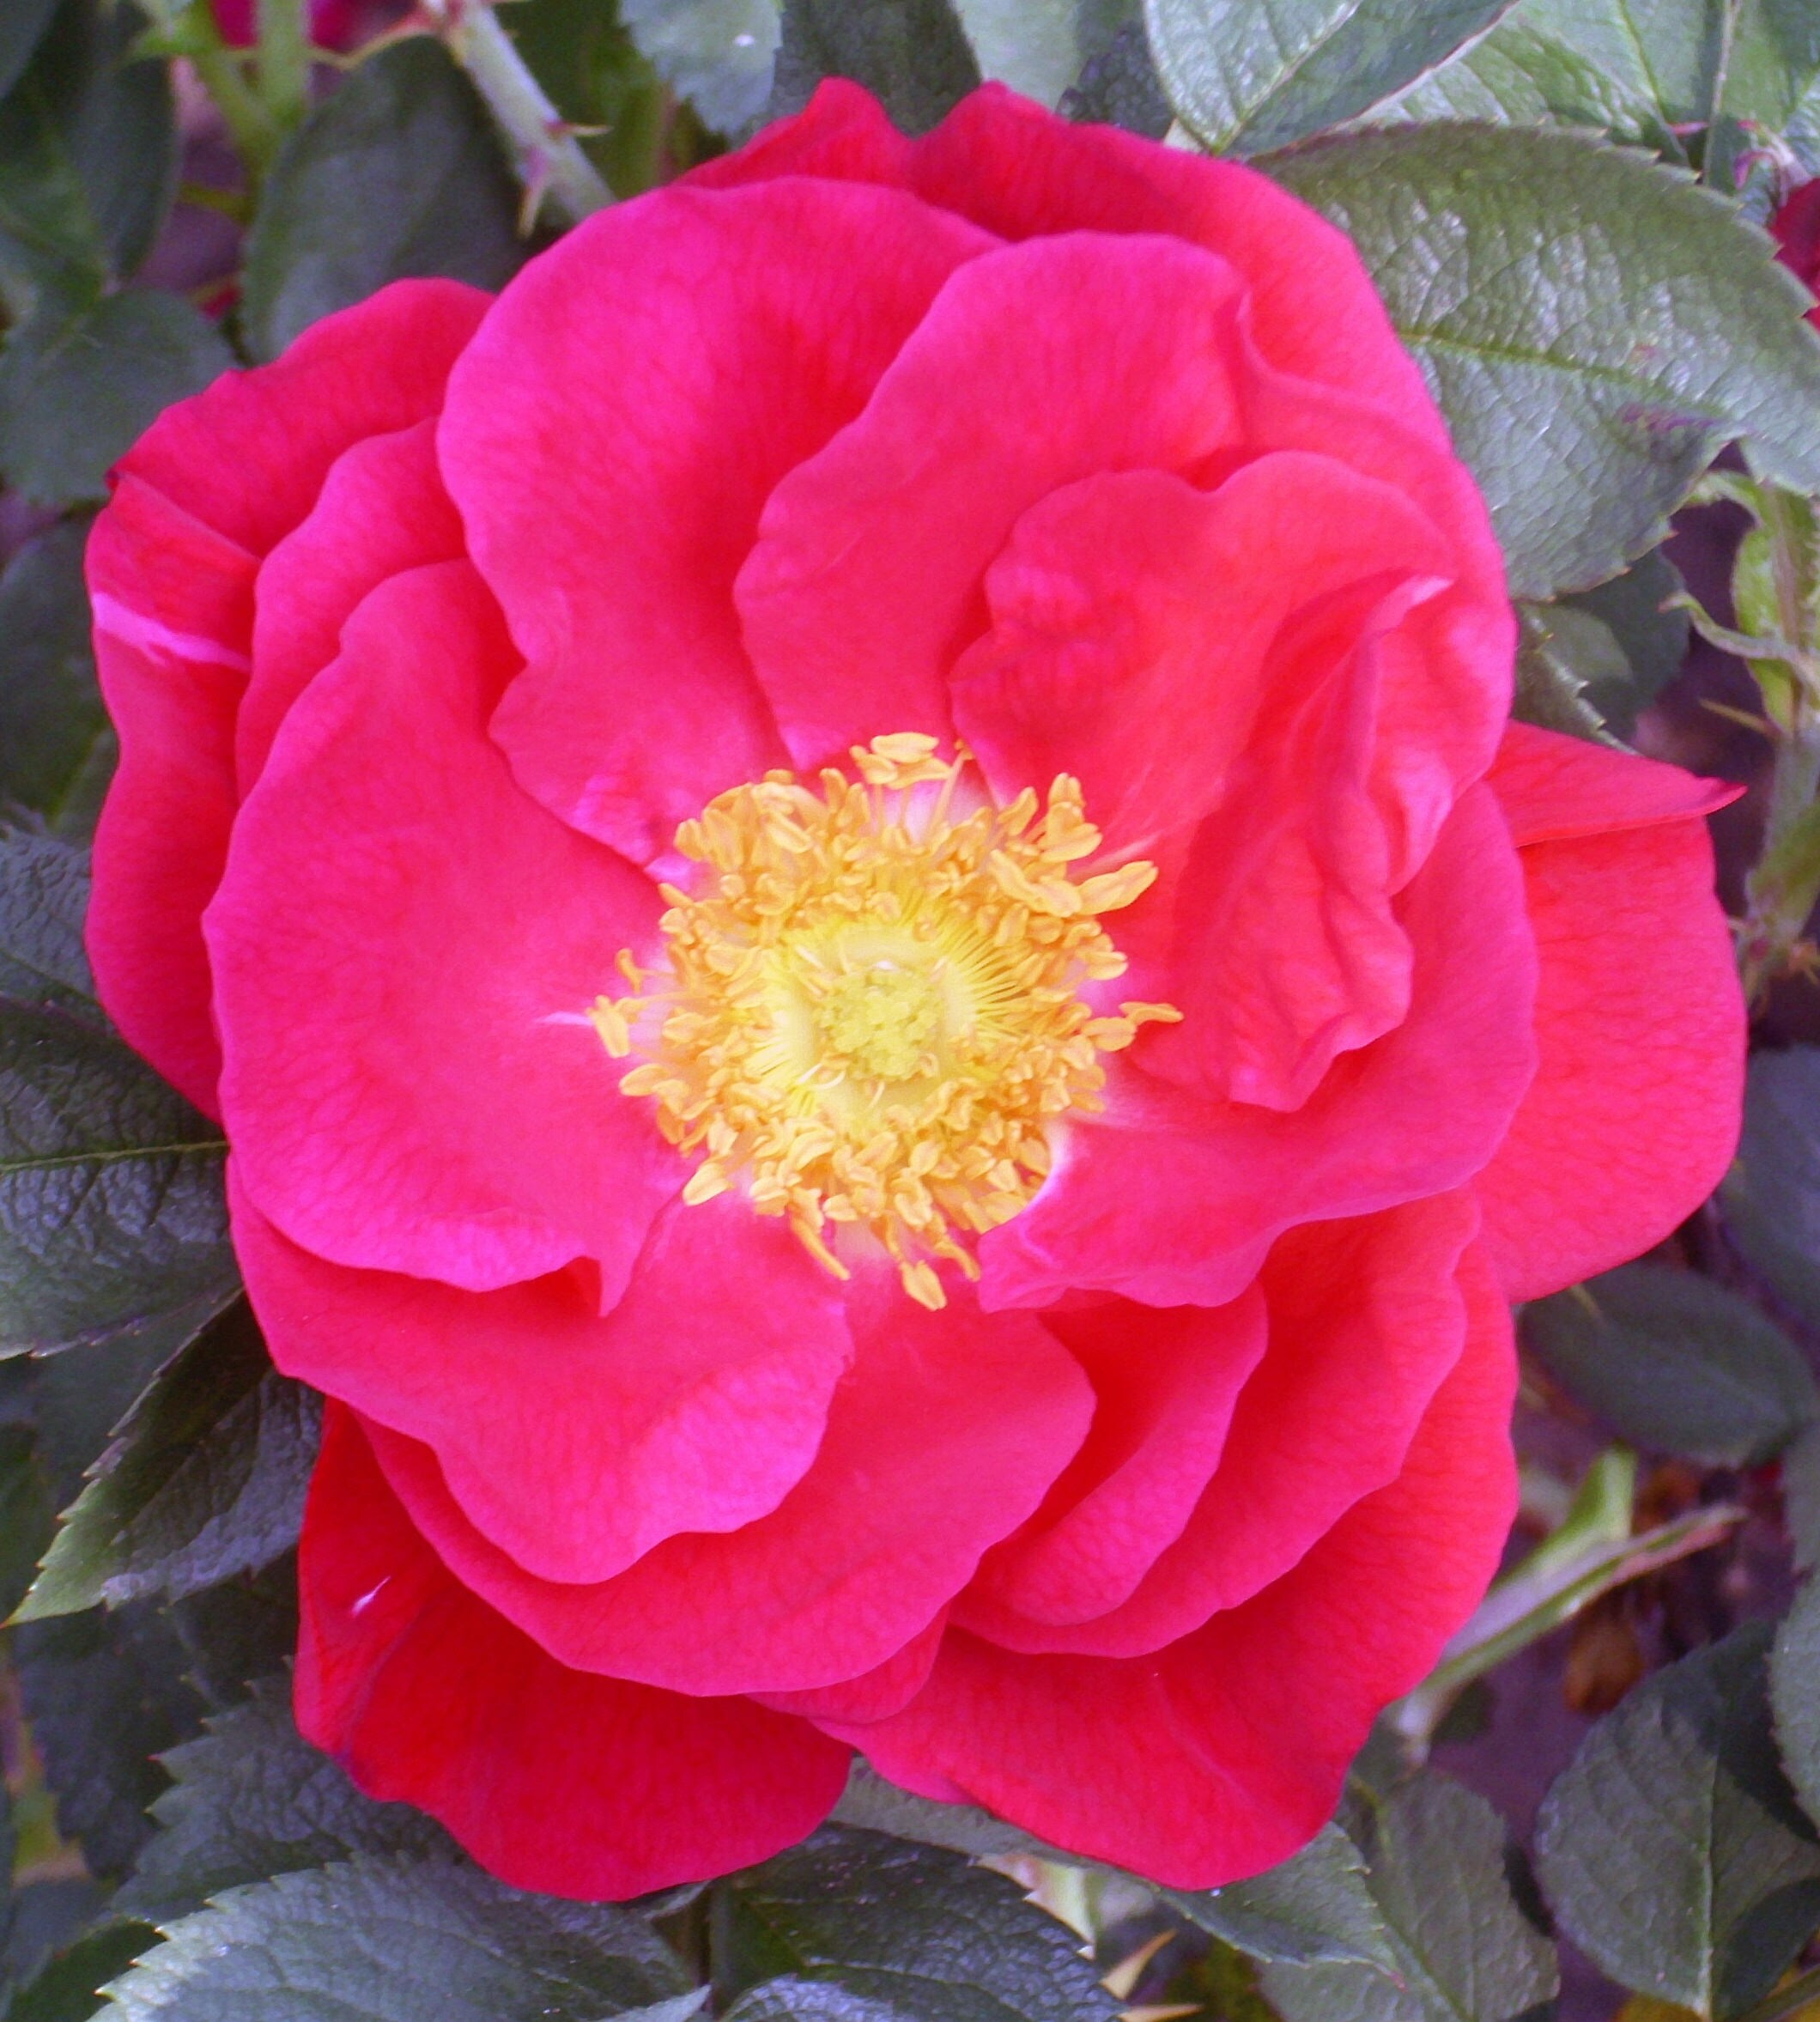
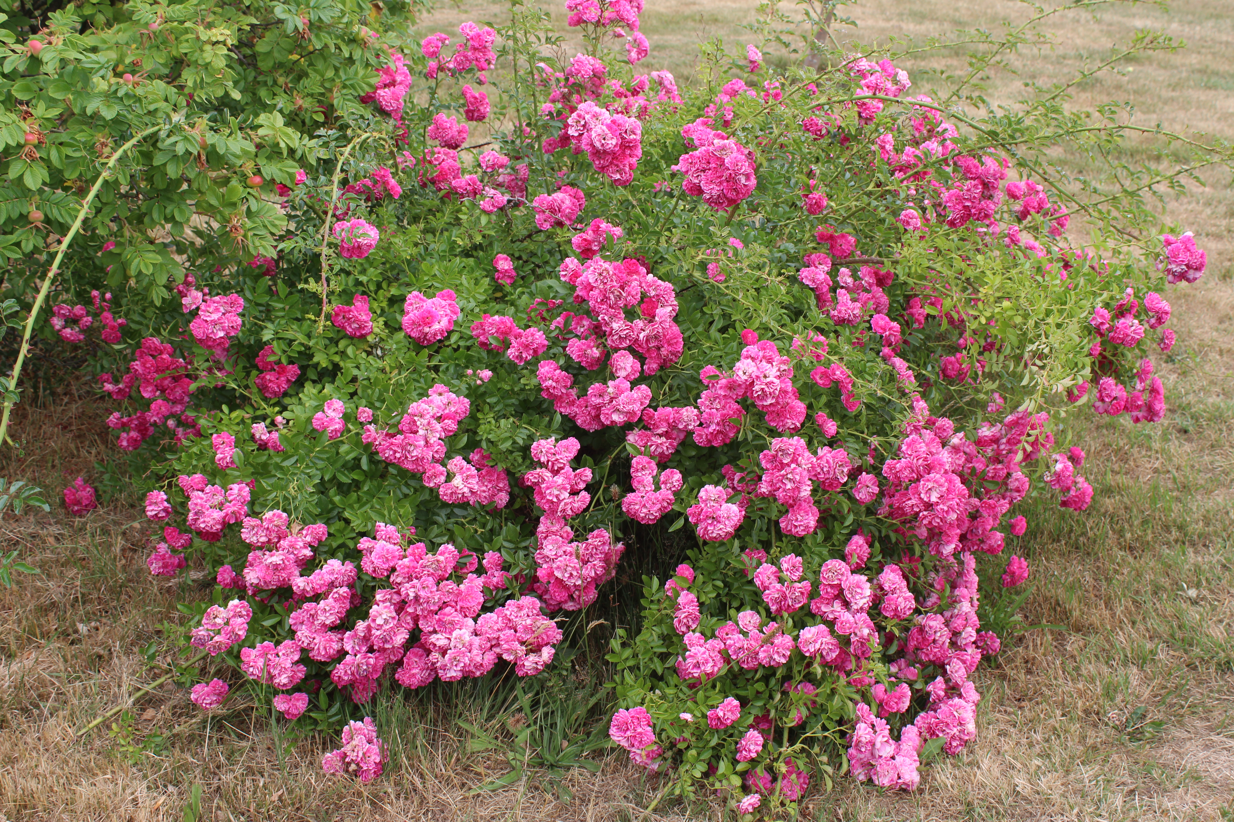
Species Roses & Heritage Roses
5-petalled Rugosa roses and hips – (taken Sweden)
This Photo by Unknown Author is licensed under CC BY-NC

Slide 7
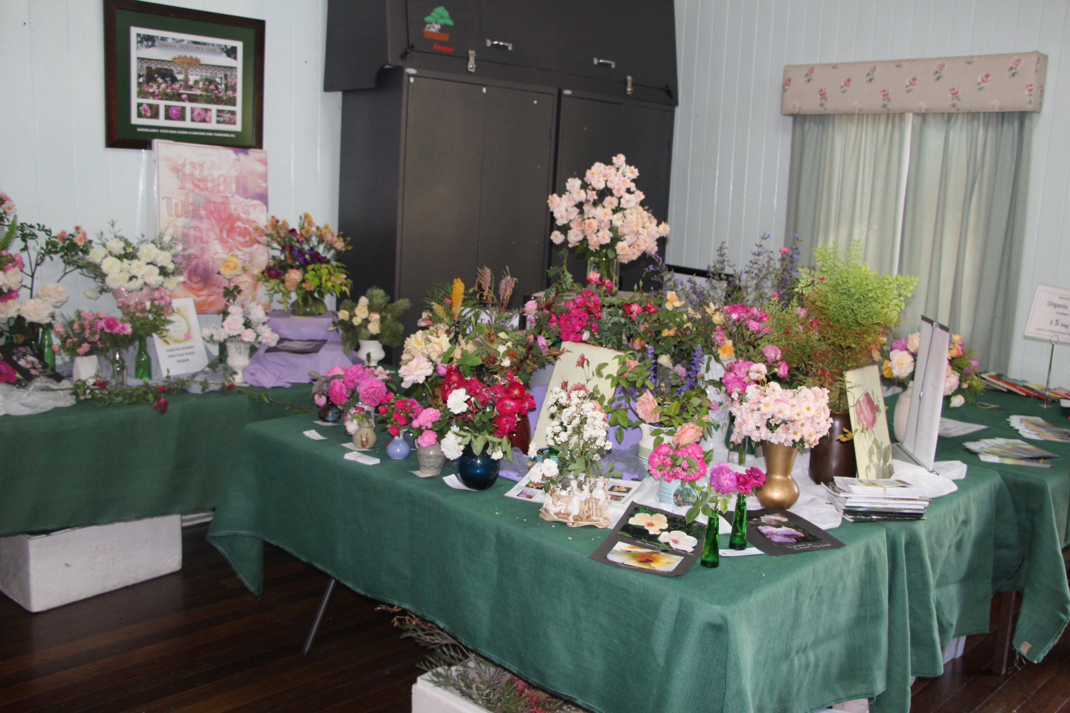
Display of Heritage Roses Oct. 2023
Bonita Cattell, Co-ordinator HRIA and Members, Toowoomba Branch,

Slide 8
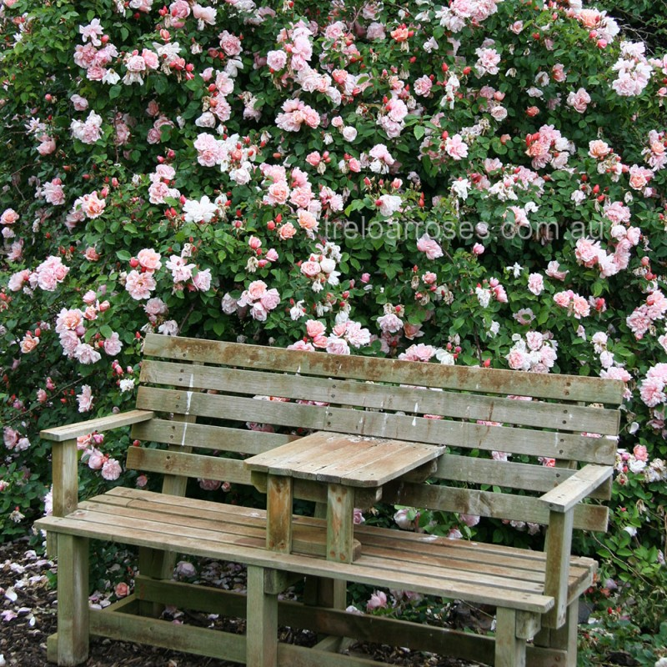
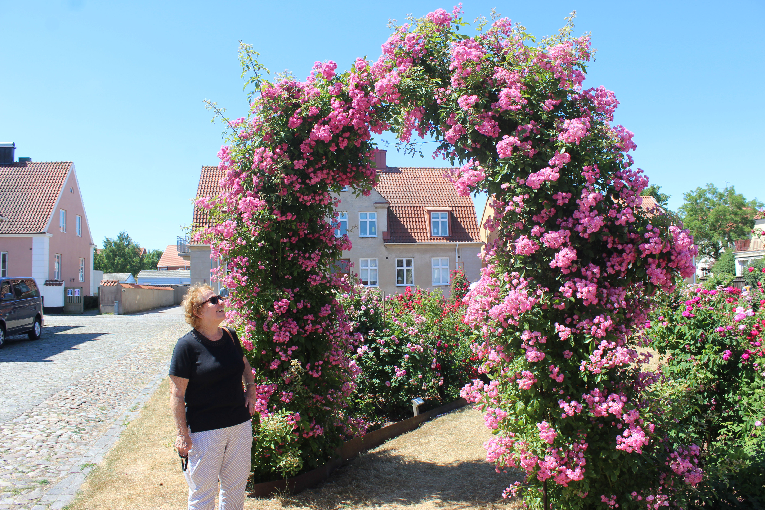
CLIMBERS
Albertine
Climbing Pinkie

Slide 9
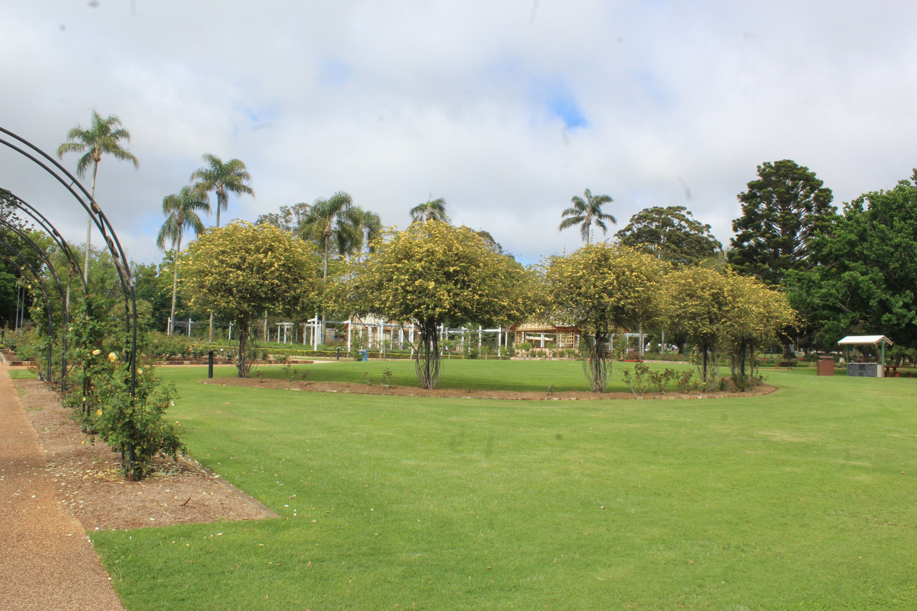
World’s Largest Rose – Climber Rosa Banksiae (white) & Rosa Banksiae Lutea (yellow) / Lady Banks Rose
Originated in China, brought to England 1807 - up to 9 m. tall × 9 m. wide.
1885 a Banksia rose in Arizona covered entire roof area of an inn – est. 9000 sq feet (840 sq m)

Slide 10
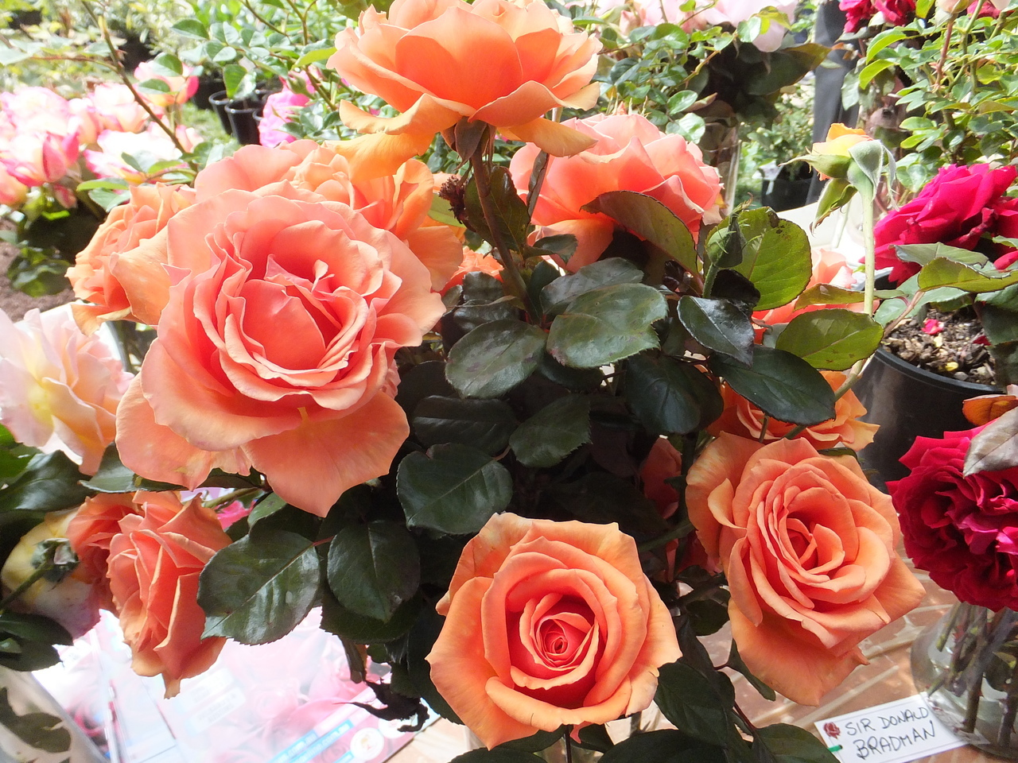
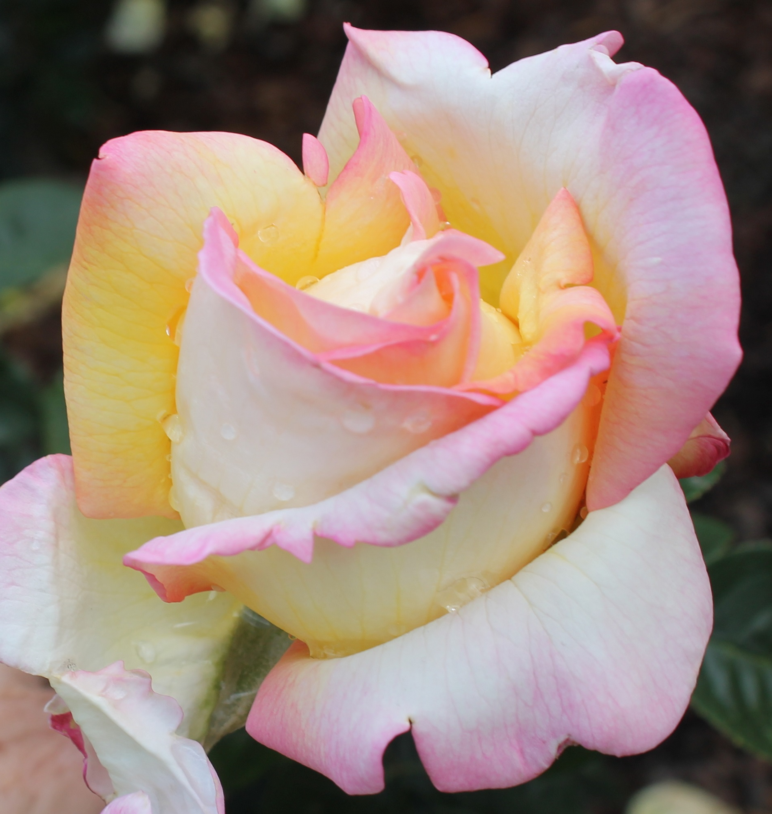
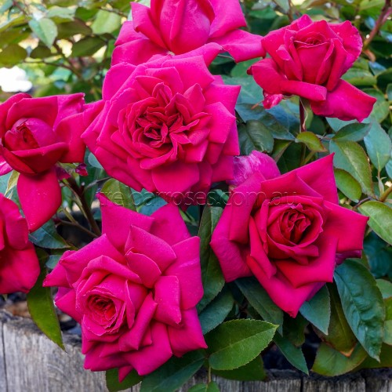
MODERN ROSES - HYBRID TEA
Toni
Peace
Ashram

Slide 11
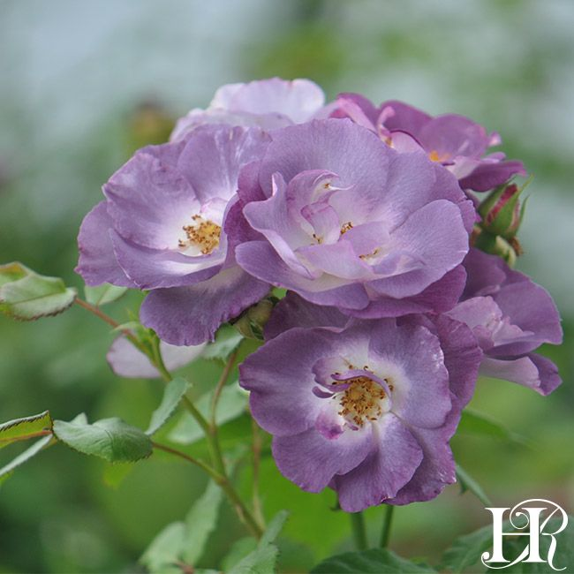
FLORIBUNDA ROSES
Single or Cluster–flowered
‘Peach Profusion’
‘Blue for You’

Slide 12
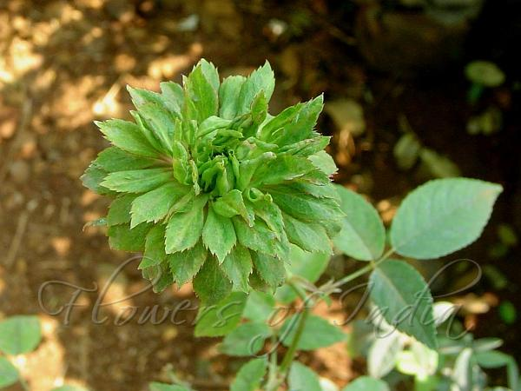
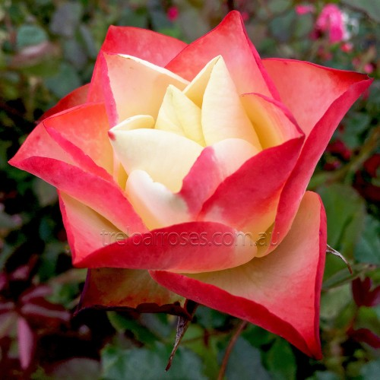
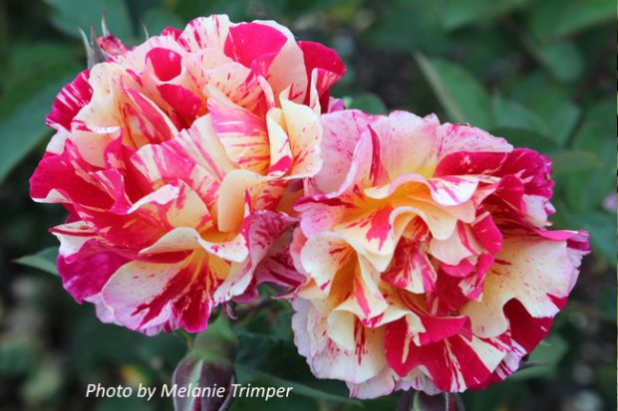
NOVELTY ROSES
Viridiflora
Novelty Roses
Origami
Maurice Utrillo
‘painted’ rose
Lemon & Lime

Slide 13
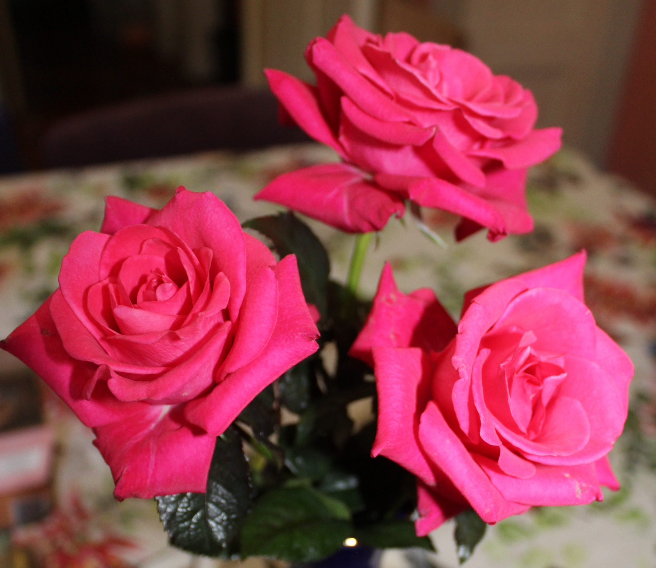
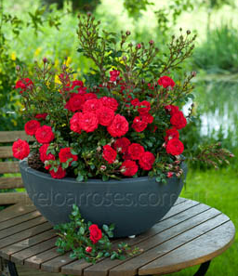
Miniature & MiniFlora Roses
Seedling miniflora roses bred by QRS member Ted Hayes.
Gra’s Blue, Silkies,
Dwarf Fairy

Slide 14
Growing Your Own Garden Roses
1. WHERE WILL YOU GROW YOUR ROSES?
Well prepared site, 5 hrs sunshine, good drainage & air circulation, avoid competition from tree roots – alternatively you can grow roses in pots.
2. PREPARE SITE 6 WEEKS IN ADVANCE- dig in compost & well rotted manure.
3. CHOOSE YOUR ROSES - ARE THEY ARE RECOMMENDED FOR QLD CONDITIONS?
See Queensland Rose Society website http://www.qld.rose.org.au/ & specialist rose nursery catalogues or websites (Swanes, Treloars,Wagners, Brindabella, etc).
Select potted plants all year or dry-rooted in Autumn/earlywinter – nursery or mail order.
4. DO YOU NEED SUPPORTS FOR CLIMBERS & STANDARDS?
5. PLANT BARE-ROOTED ROSES IN A POT TO GIVE THEM A GOOD START, but can plant directly in well prepared spot in ground. Never allow roots of dry rooted roses to dry out.
For both pots and garden planting ensure bud union is at ground level and water well. Plant Hybrid Tea roses 2 metres apart, smaller floribundas 1.5 metres.
DO NOT USE ANY FERTLIISER WHEN PLANTING BARE-ROOTED ROSES. Keep up water, snip off any buds until plant is growing strongly – when established, can apply Sudden Impact or other fertilizer for potted or garden roses.

Slide 15
What’s a graft bud?? Most Modern Roses are Grafted
graft
mulch
water
roots

Slide 16
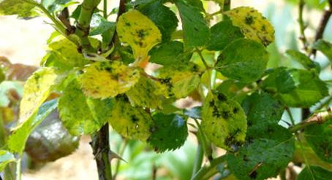
COMMON PROBLEMS: Black Spot, Powdery Mildew,
Downey Mildew, Red Spider & Rust
Use Bordeaux, Triforine, Mancozeb fungicide or other copper based product - or a mixture.
Or Eco safe alternative
b) Jeremy Colby Williams Mix two tspns of bicarb soda in 5 litres of water, add a couple of drops of detergent or couple of drops of seaweed extract (eg Seasol) and spray. Washes off in rain or after watering leaves – re spray.
a) Silkies In 10 litre bucket, mix ¼ cup Eco spray Rose, 1 heaped tspn Eco-Seaweed powder, & ¼ cup Eco-Oil. Spray until runs off.

Slide 17
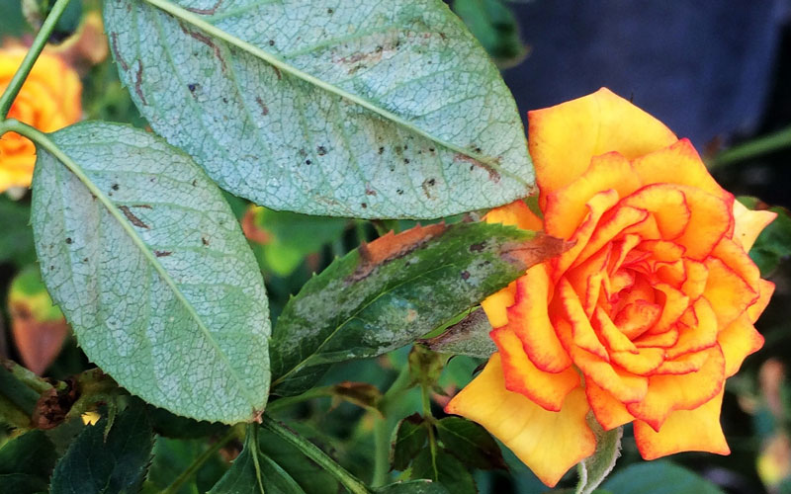
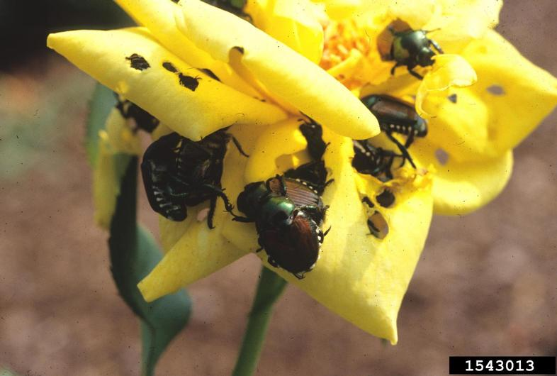
Safe & Organic Remedy for Black Spot
For Caterpillars, grass hoppers – use proprietary pesticides eg Brunnings Rose Spray, Yates Rose Gun, Hortico Rose Spray.
For Red Spider Mite, Scale – Use oil-based spray on both sides of leaf or spray of water from hose.
Hibiscus beetles – Confidor, Neem, Pea Beu fast Killing Spray (ruins flowers).
Leaf cutter – caused by bees, allow leaves to regrow naturally.

Slide 18
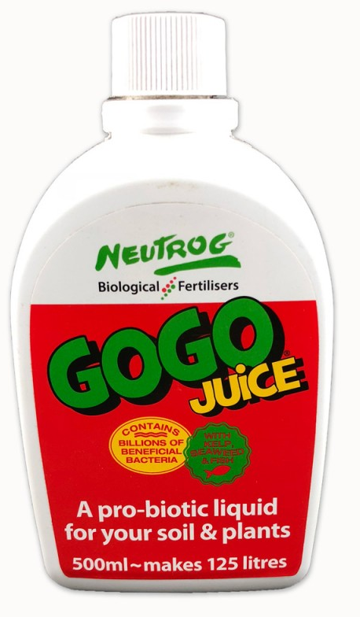
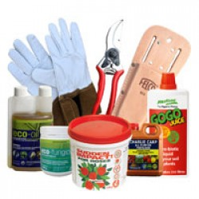
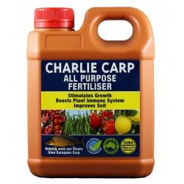
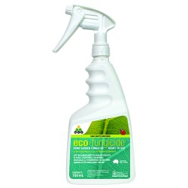
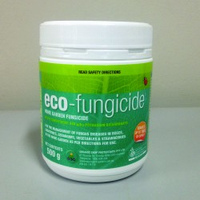
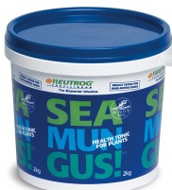

Slide 19
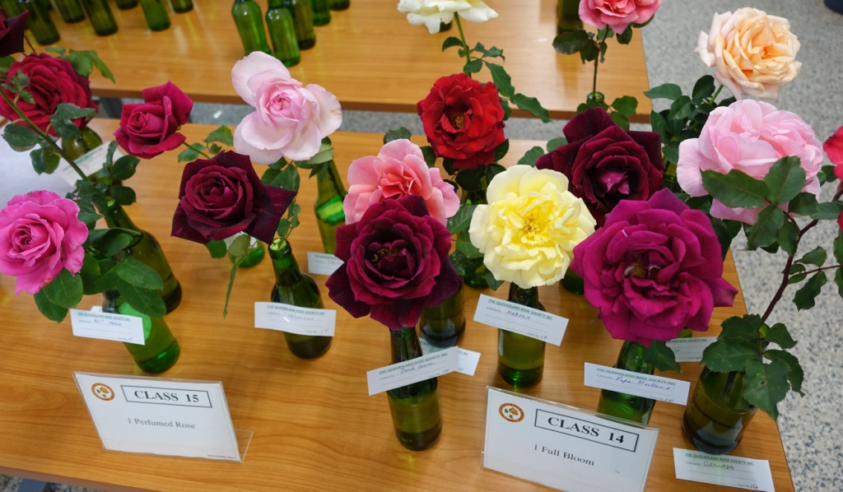
TO LEARN MORE JOIN A ROSE SOCIETY
QRS Meets 7pm, 2nd Wednesday of month, at Church Hall, 459 Annerley Road, Annerley Junction. Next meeting 7pm 8 Nov. check QRS website calendar.

