Slide 1
Coomera Valley Probus Club
Tasmania 9 day Tour November 2013
John Keays
June 2013
Notes:
This template can be used as a starter file for presenting training materials in a group setting.
Sections
Right-click on a slide to add sections. Sections can help to organize your slides or facilitate collaboration between multiple authors.
Notes
Use the Notes section for delivery notes or to provide additional details for the audience. View these notes in Presentation View during your presentation.
Keep in mind the font size (important for accessibility, visibility, videotaping, and online production)
Coordinated colors
Pay particular attention to the graphs, charts, and text boxes.
Consider that attendees will print in black and white or grayscale. Run a test print to make sure your colors work when printed in pure black and white and grayscale.
Graphics, tables, and graphs
Keep it simple: If possible, use consistent, non-distracting styles and colors.
Label all graphs and tables.

Slide 2
Show and Tell this presentation
Follow the published itinerary of Probus trip.
Add some extra venues that we visited.
Based on my trips to Tasmania 2006,9 and 2012.
Most photos are ours but added tourists shots where I have not visited.
About 50 slides can take questions on the fly
I have cousins at Cranbrook near Swansea.
I offered to do the talk to Ray and Estelle.
My wife Sue is here to answer questions too…

Slide 3
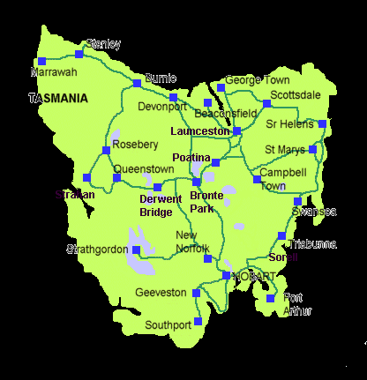
Map of Tasmania
Notes:
Give a brief overview of the presentation. Describe the major focus of the presentation and why it is important.
Introduce each of the major topics.
To provide a road map for the audience, you can repeat this Overview slide throughout the presentation, highlighting the particular topic you will discuss next.

Slide 4
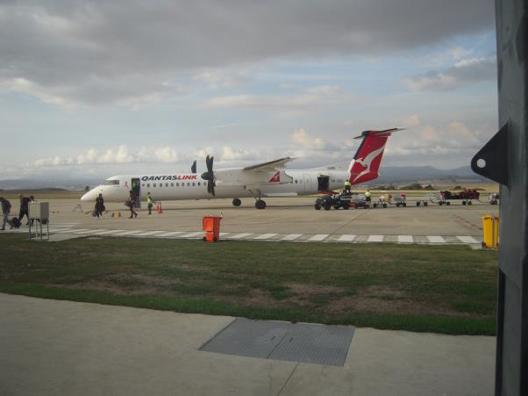
Launceston Airport

Slide 5
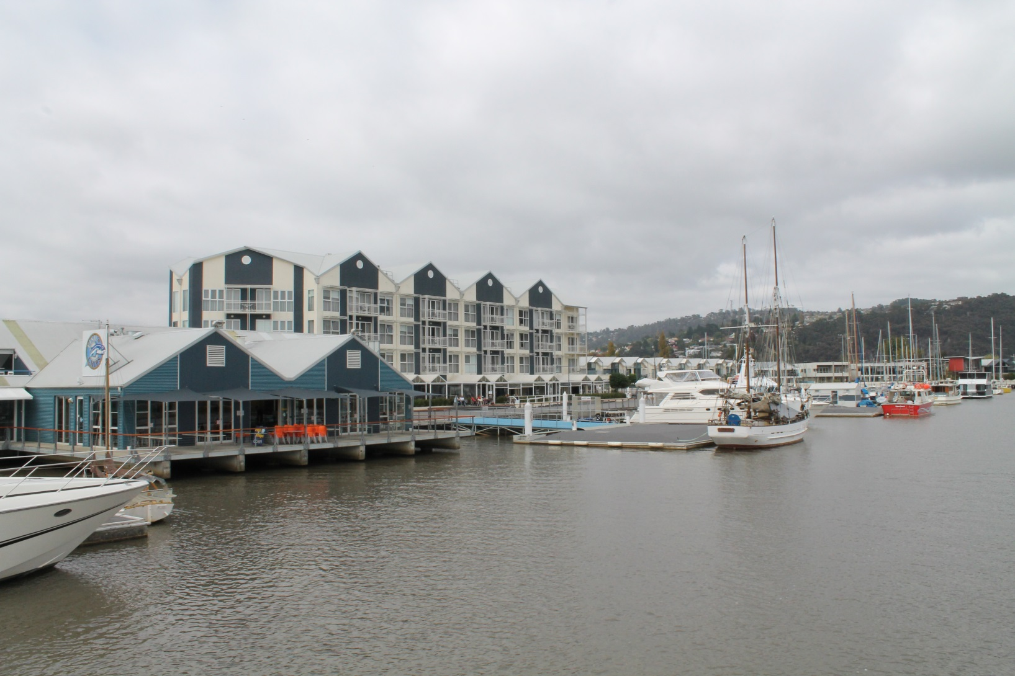
The Launceston Wharf

Slide 6
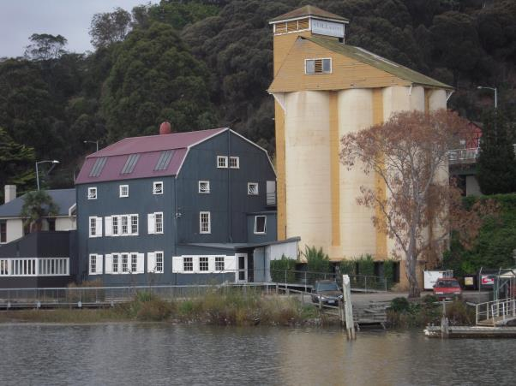
Tamar River Cruise, old flour mill

Slide 7
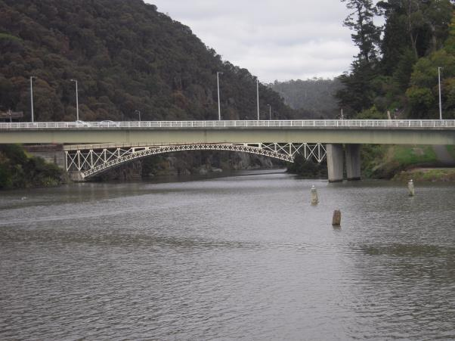
First stop Cataract Gorge, Launceston
Notes:
Give a brief overview of the presentation. Describe the major focus of the presentation and why it is important.
Introduce each of the major topics.
To provide a road map for the audience, you can repeat this Overview slide throughout the presentation, highlighting the particular topic you will discuss next.

Slide 8
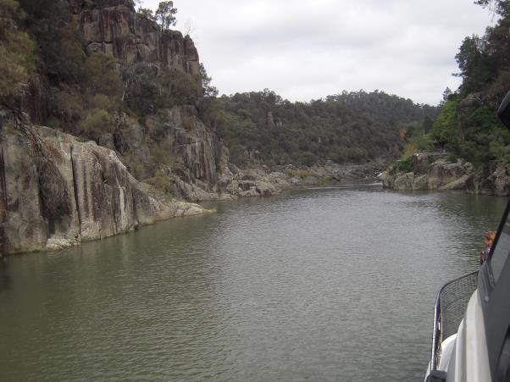
Cataract Gorge, upstream

Slide 9
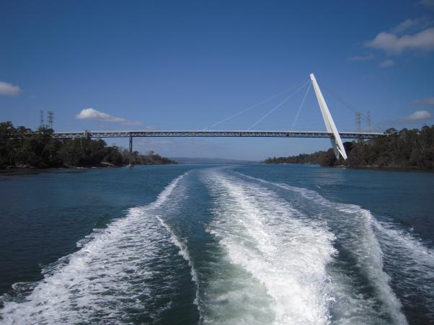
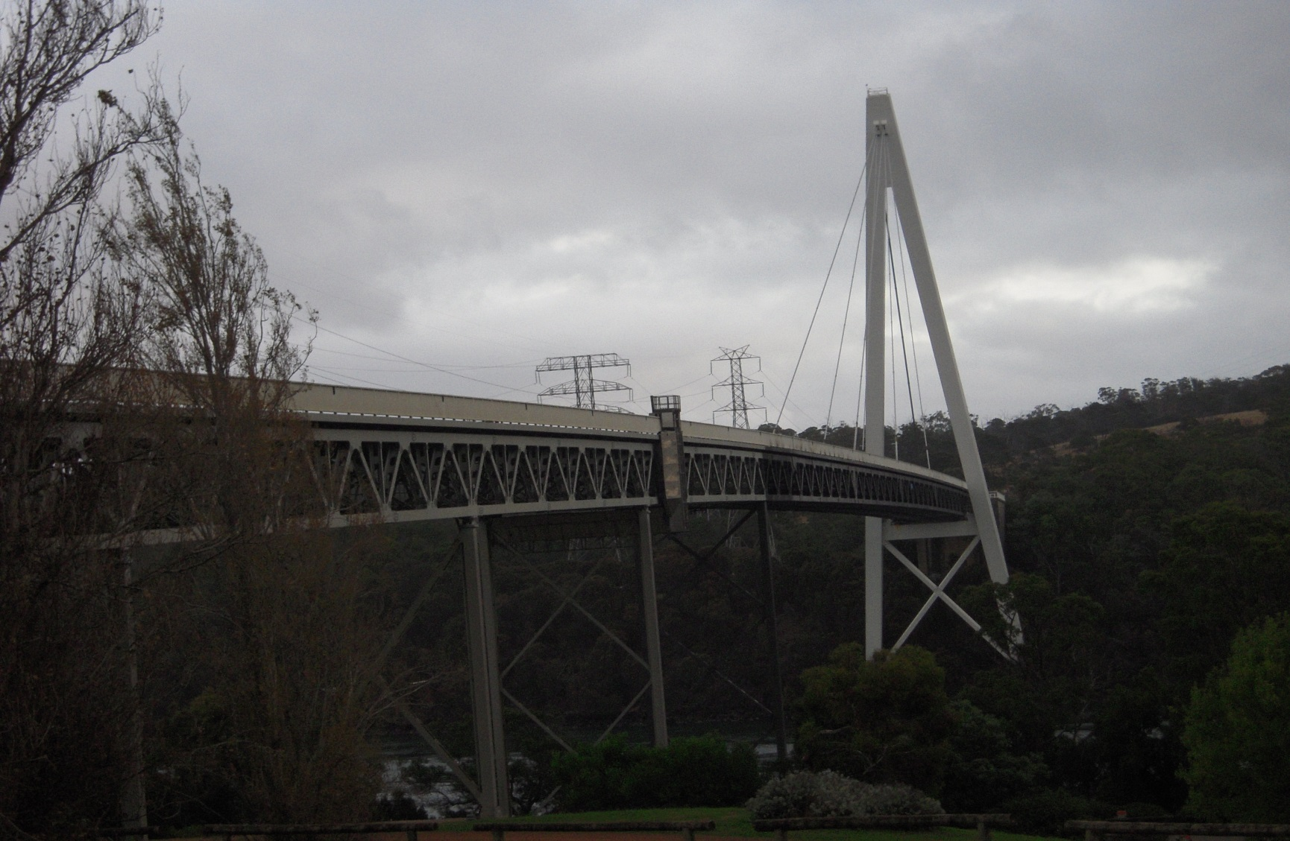
Tasman Bridge in Tamar Estuary

Slide 10
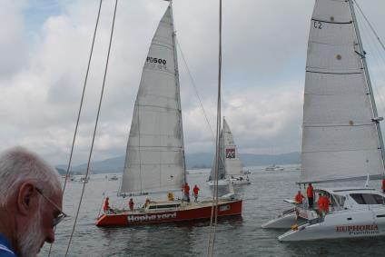
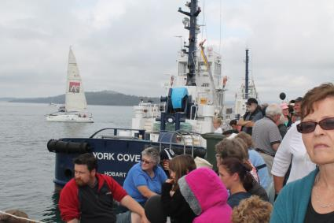
3 Mountain Race Start, Beaconsfield
Jostling at the start
Shops on wharf
Estuary of the Tamar River

Slide 11
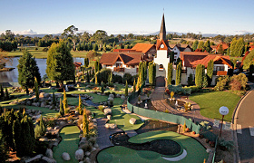
Grindelwald Village

Slide 12
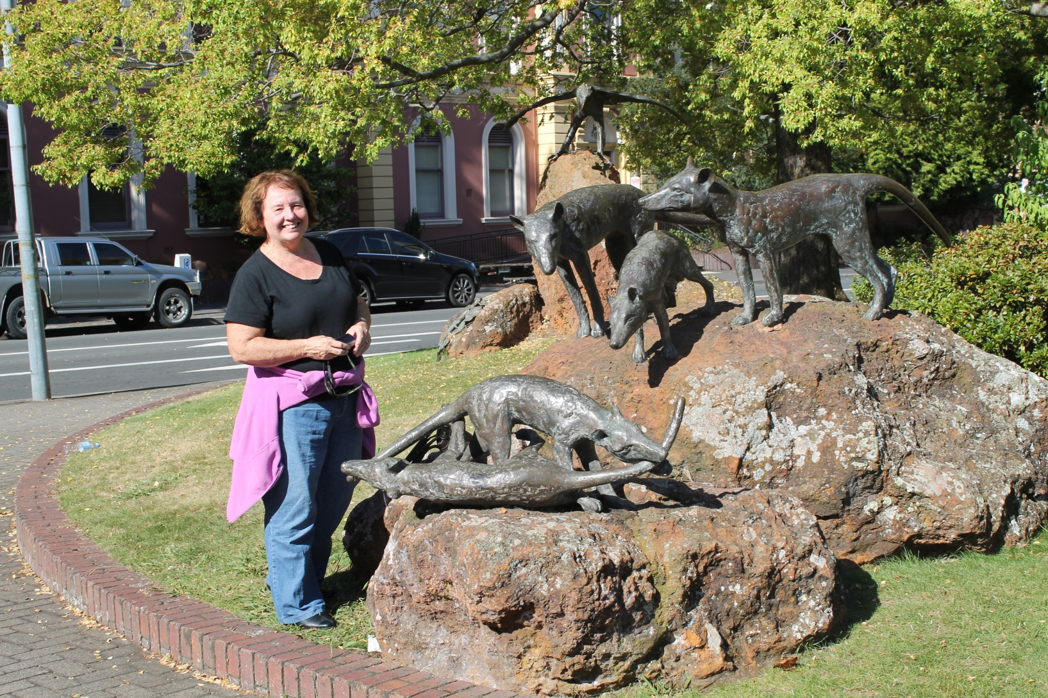
Tasmanian Devils in Launceston

Slide 13
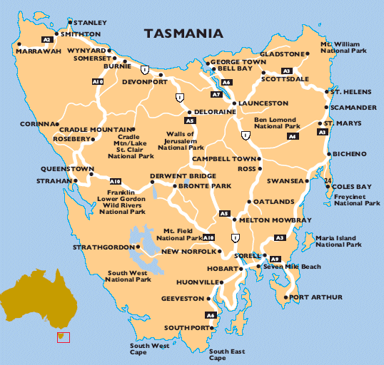

Slide 14

At Nabowla established 1921

Slide 15
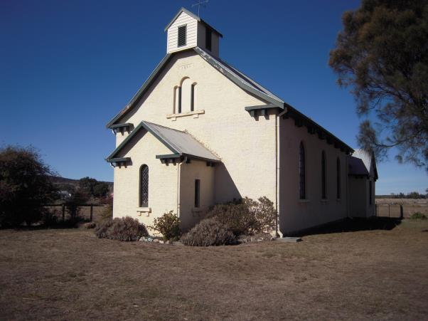
Cranbrook Church built by Adam Amos 1825
Notes:
Give a brief overview of the presentation. Describe the major focus of the presentation and why it is important.
Introduce each of the major topics.
To provide a road map for the audience, you can repeat this Overview slide throughout the presentation, highlighting the particular topic you will discuss next.

Slide 16
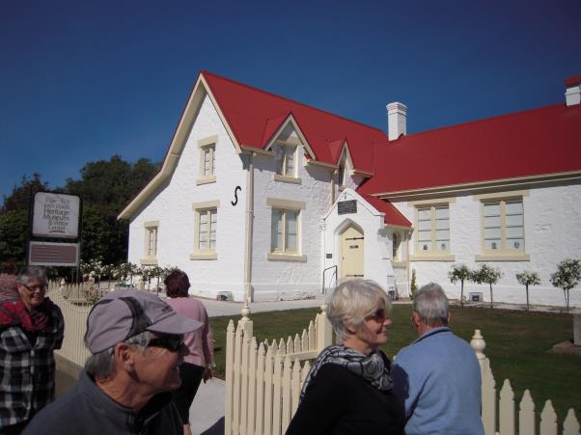
Swansea Museum, East Coast

Slide 17
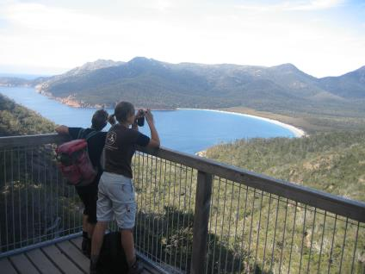
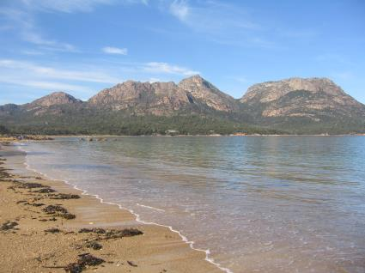
Wine Glass Bay … Freycinet
A little walk up the hill
On the beach

Slide 18
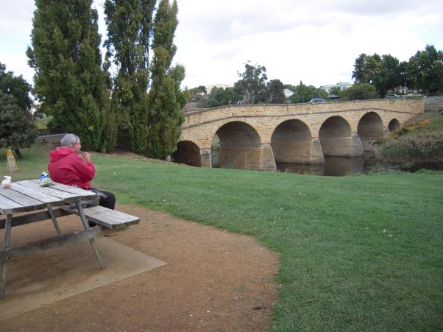
Richmond Bridge built 1825
Oldest bridge In Australia
Notes:
Give a brief overview of the presentation. Describe the major focus of the presentation and why it is important.
Introduce each of the major topics.
To provide a road map for the audience, you can repeat this Overview slide throughout the presentation, highlighting the particular topic you will discuss next.

Slide 19
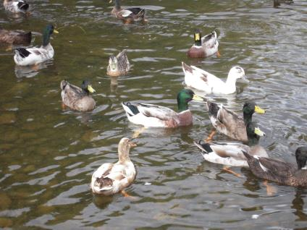
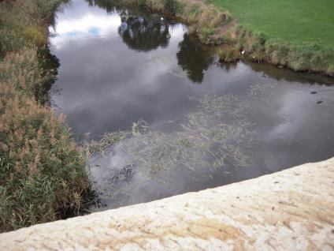
Richmond Bridge
Ducks
From the Bridge

Slide 20
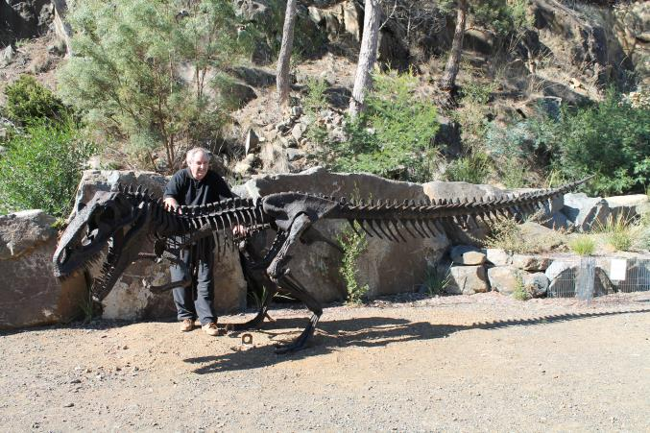
On to Hobart - Quarry on Road
The old dinosaurs

Slide 21
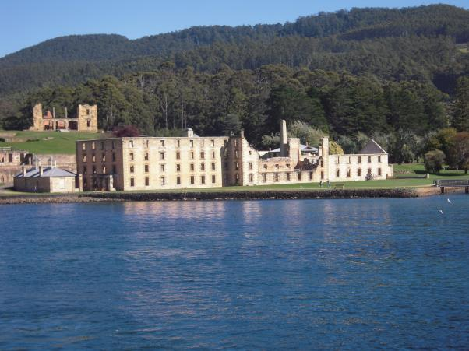
Port Arthur, Penal Settlement
Port Arthur Convict Settlement 1820-1850
Notes:
Give a brief overview of the presentation. Describe the major focus of the presentation and why it is important.
Introduce each of the major topics.
To provide a road map for the audience, you can repeat this Overview slide throughout the presentation, highlighting the particular topic you will discuss next.

Slide 22
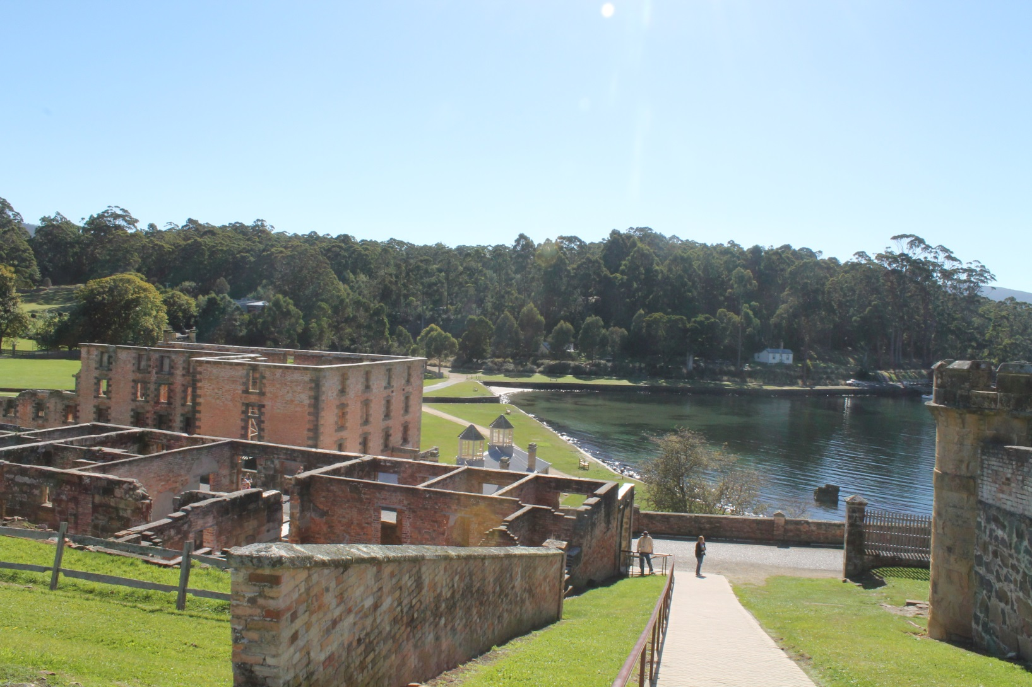
Main prison building

Slide 23
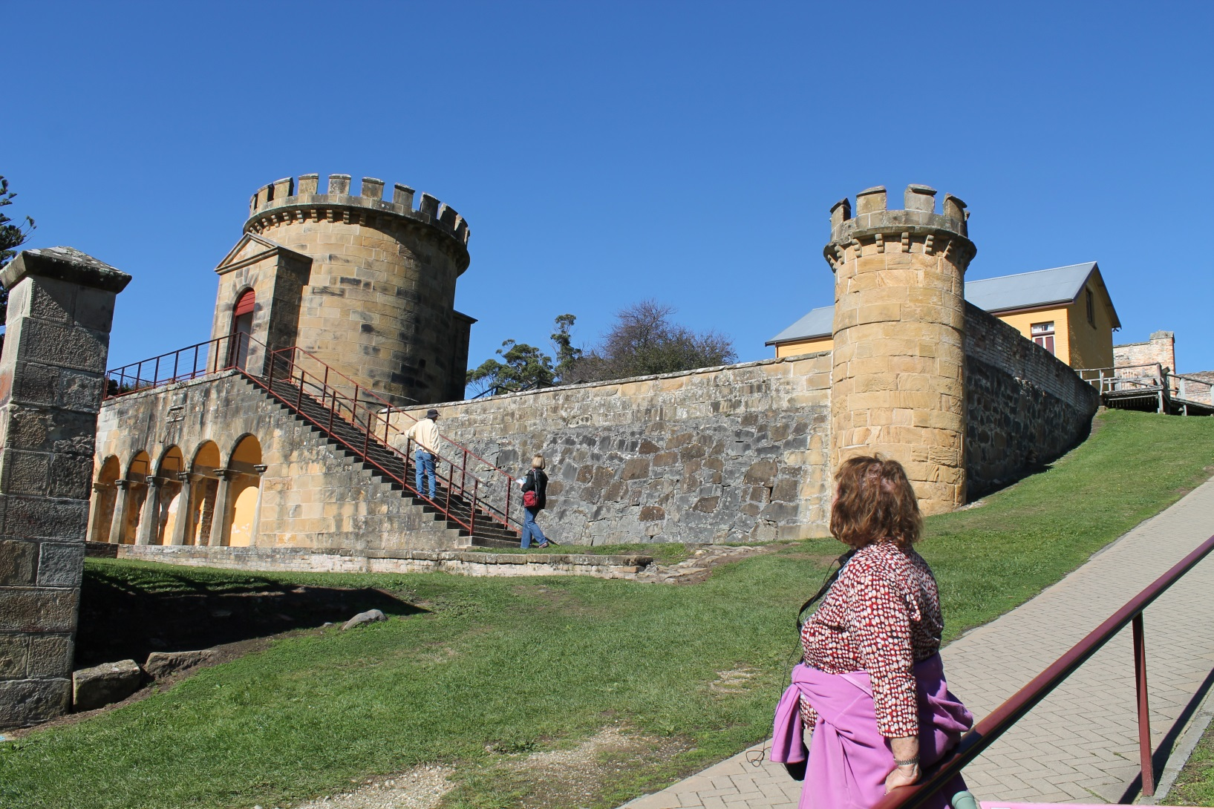
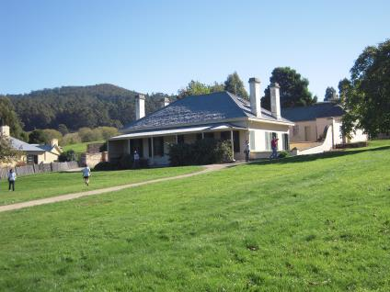
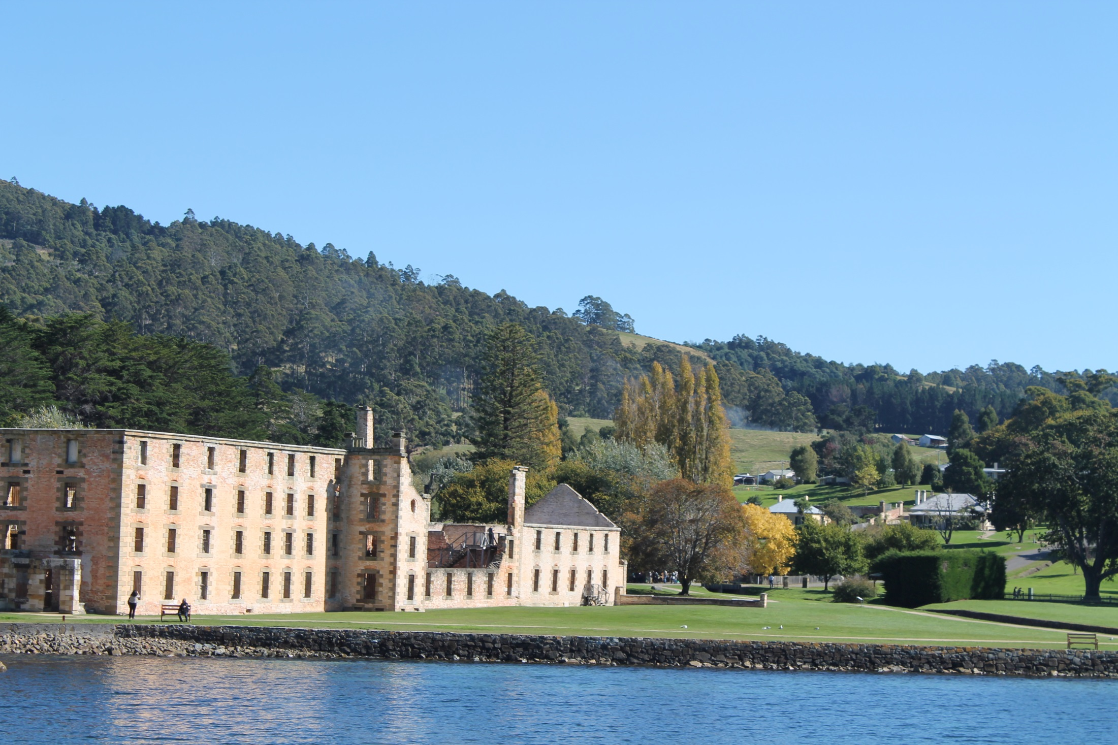
Port Arthur
Huge &
Great

Slide 24
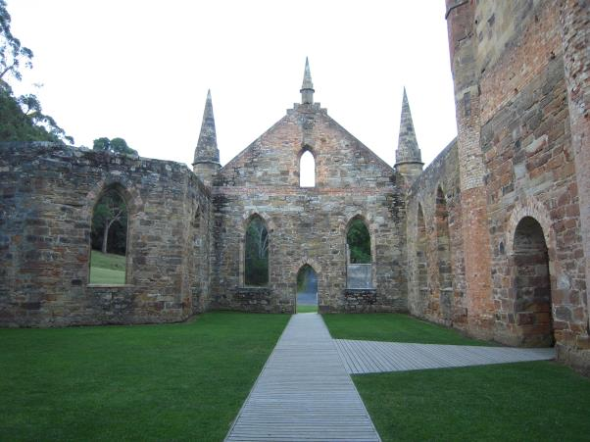
Stonework, old Chapel at Port Arthur

Slide 25
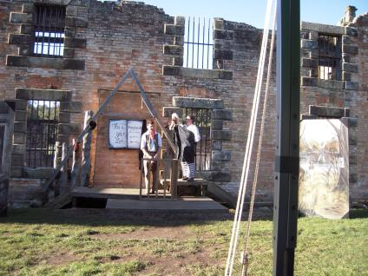
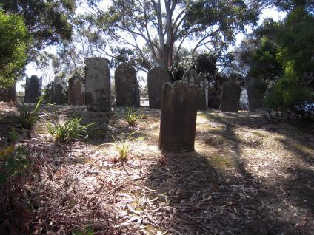
Port Arthur Island of the Dead

Slide 26
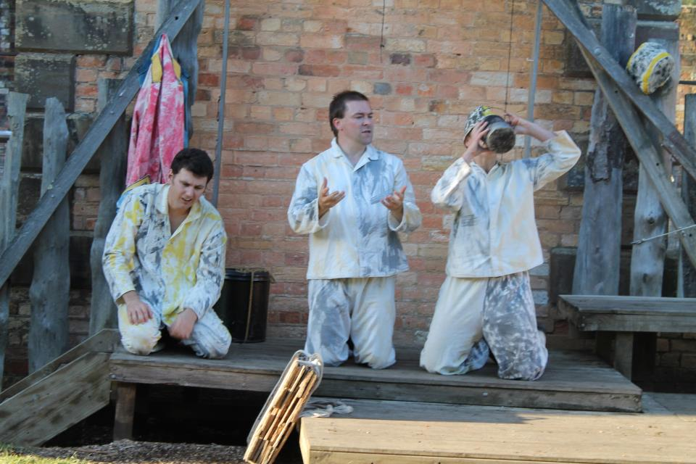
For the term of his natural Life ... Re-enactment Port Arthur

Slide 27
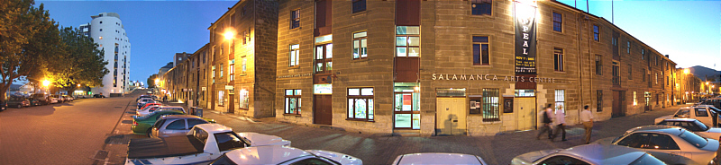
Salamanca Markets
On Saturdays, Salamanca Place comes alive with the famous Salamanca Market operated by the Hobart City Council. Over 300 stallholders sell fresh and gourmet produce, arts, crafts and handiwork crafts from all over Tasmania, interstate and overseas.
Notes:
Give a brief overview of the presentation. Describe the major focus of the presentation and why it is important.
Introduce each of the major topics.
To provide a road map for the audience, you can repeat this Overview slide throughout the presentation, highlighting the particular topic you will discuss next.

Slide 28
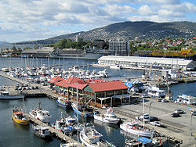
Constitution Dock Hobart adjoining Salamanca

Slide 29
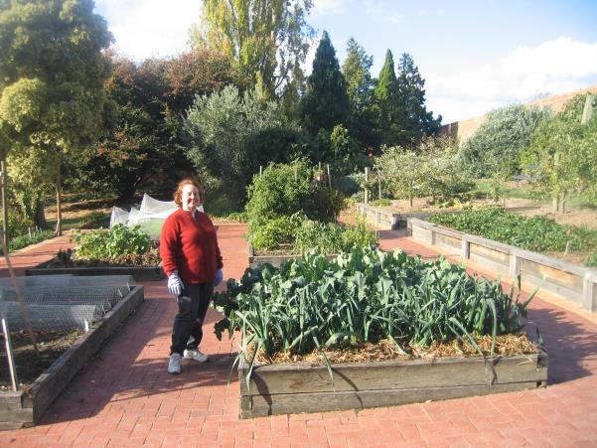
Pete’s Corner Botanic Gardens Hobart

Slide 30
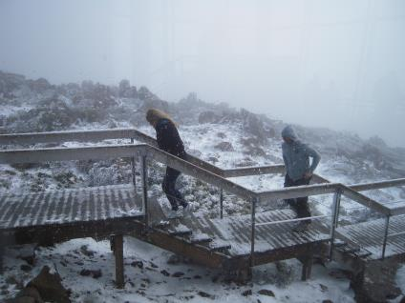
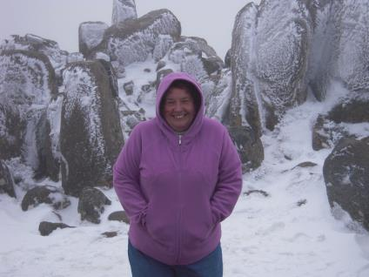
Top of Mt Wellington, mighty chilly

Slide 31
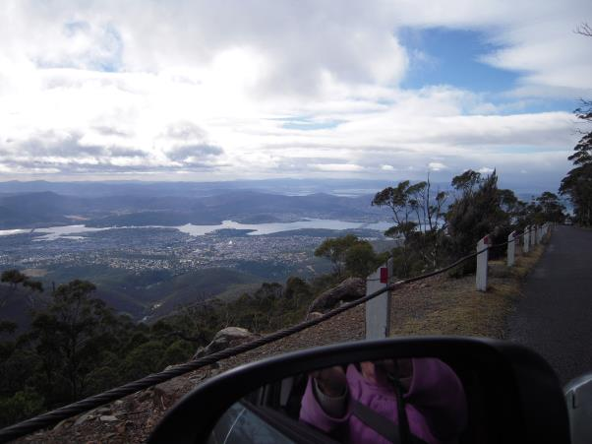
The view, halfway down Mt Wellington

Slide 32
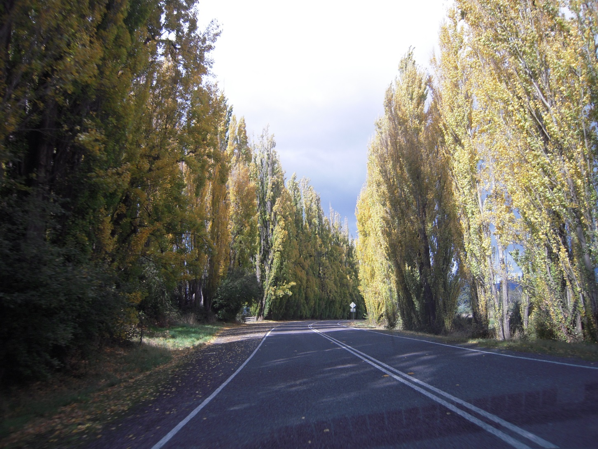
Road to New Norfolk

Slide 33
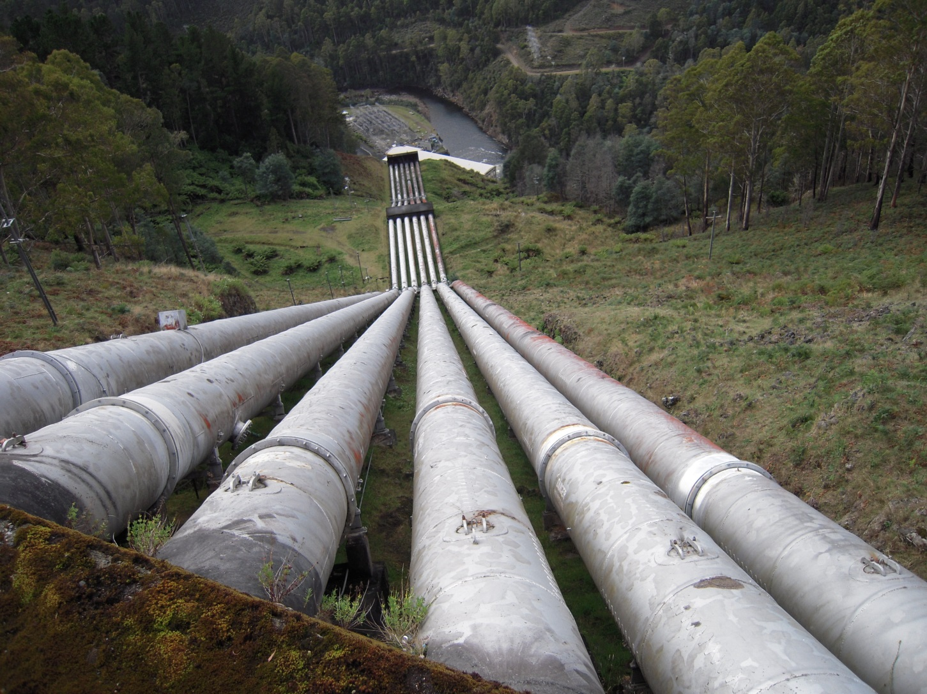
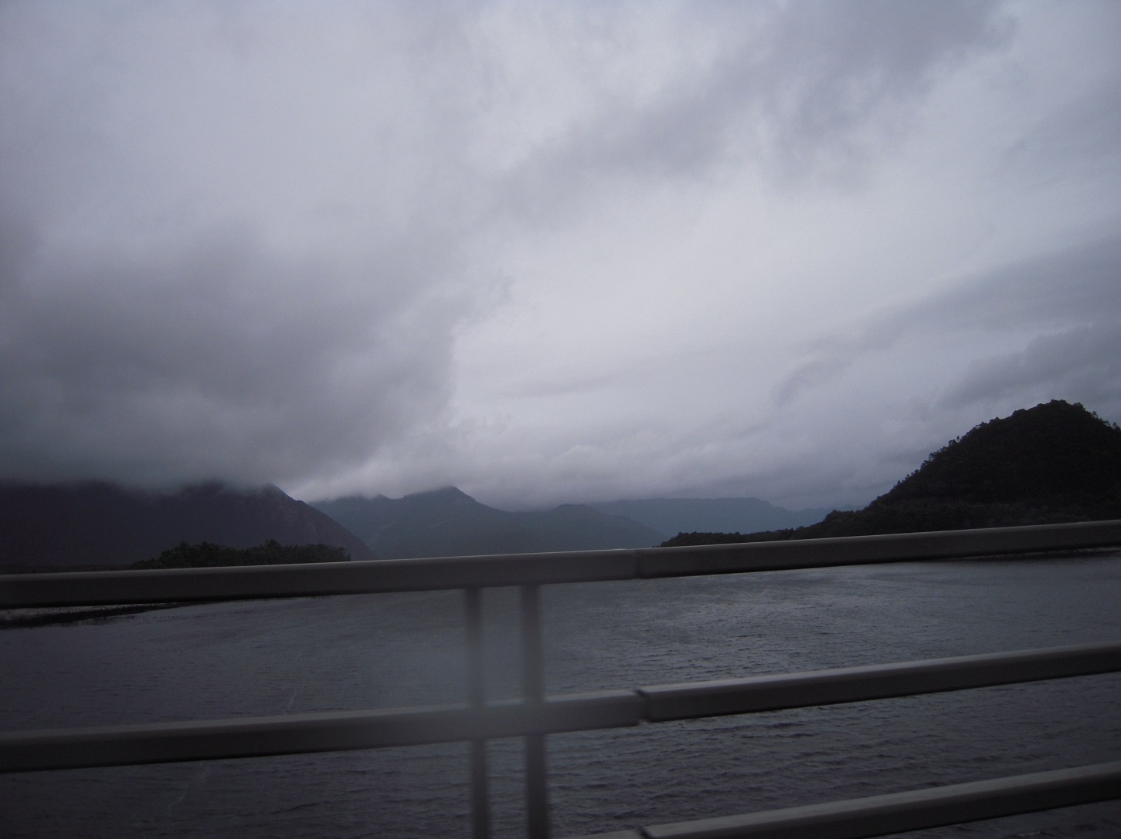
To West Coast - Derwent Bridge

Slide 34
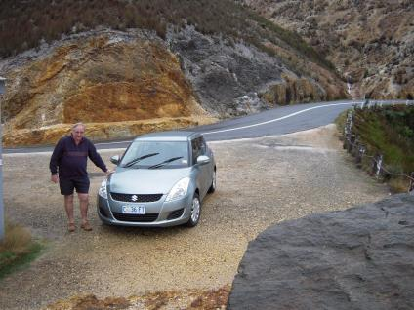
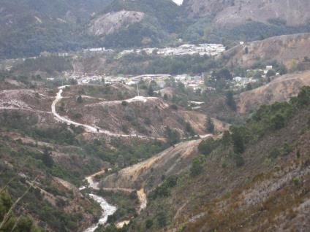
Queenstown, Mt Lyell Copper 1960
Sulphur encrusted rocks
Decimated landscape from mining
Notes:
Give a brief overview of the presentation. Describe the major focus of the presentation and why it is important.
Introduce each of the major topics.
To provide a road map for the audience, you can repeat this Overview slide throughout the presentation, highlighting the particular topic you will discuss next.

Slide 35
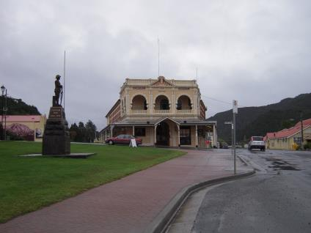
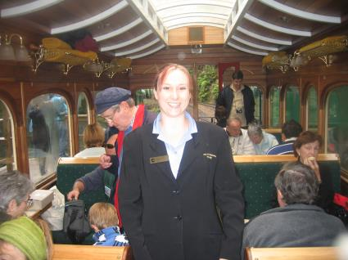
Wilderness Railway
Queenstown Railway Station
On Board Guide

Slide 36
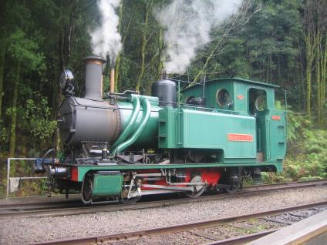
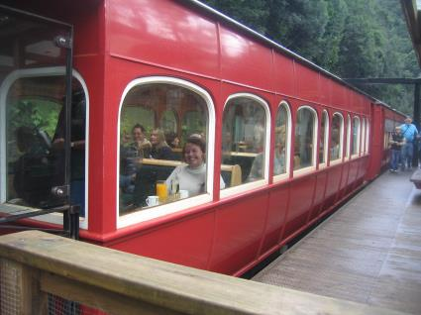
Wilderness Railway
Restored 1880 engine
Sue having drinks

Slide 37
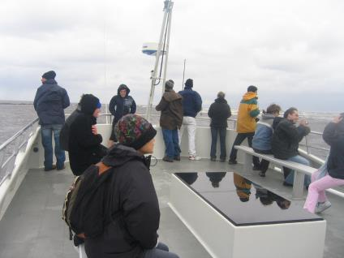
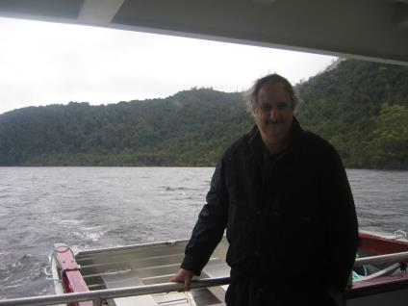
Gordon River Cruise
Notes:
Give a brief overview of the presentation. Describe the major focus of the presentation and why it is important.
Introduce each of the major topics.
To provide a road map for the audience, you can repeat this Overview slide throughout the presentation, highlighting the particular topic you will discuss next.

Slide 38
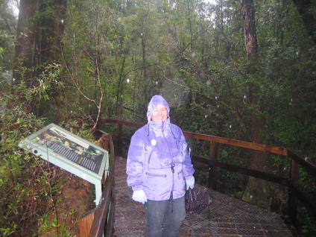
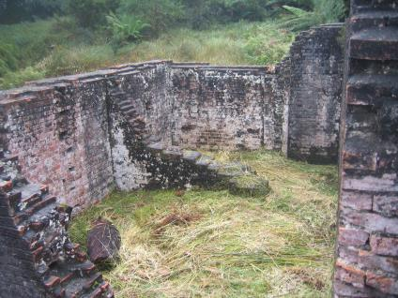
Bush walk & Convict ruins Sarah Is.

Slide 39
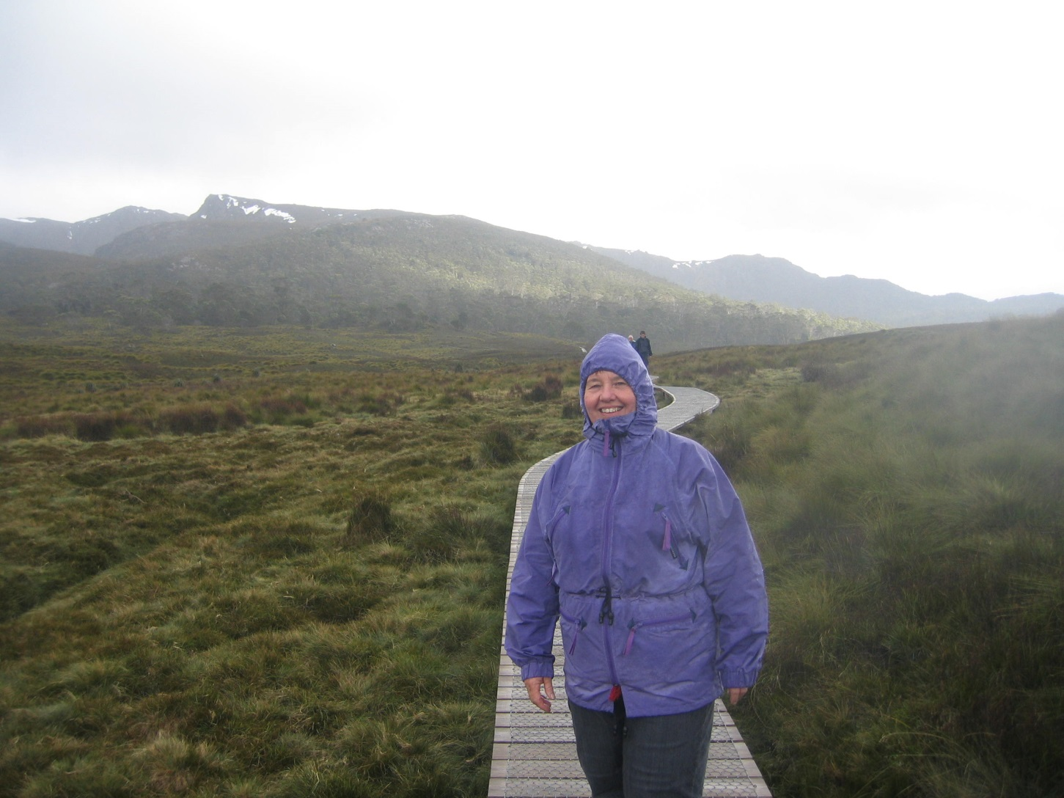


Cradle Mountain
In summer no snow
Summer rains
Board walks
Notes:
Give a brief overview of the presentation. Describe the major focus of the presentation and why it is important.
Introduce each of the major topics.
To provide a road map for the audience, you can repeat this Overview slide throughout the presentation, highlighting the particular topic you will discuss next.

Slide 40

Stanley Convict Barracks 1834-6
- 41 Convicts

Slide 41

The Nut, Stanley, Tassie’s Ayre’s Rock

Slide 42

Notes:
Give a brief overview of the presentation. Describe the major focus of the presentation and why it is important.
Introduce each of the major topics.
To provide a road map for the audience, you can repeat this Overview slide throughout the presentation, highlighting the particular topic you will discuss next.

Slide 43

Entry road to Woolmers

Slide 44

Woolmers National Rose Garden
Notes:
Give a brief overview of the presentation. Describe the major focus of the presentation and why it is important.
Introduce each of the major topics.
To provide a road map for the audience, you can repeat this Overview slide throughout the presentation, highlighting the particular topic you will discuss next.

Slide 45


Slide 46

The Woolmer’s Residence
Notes:
Give a brief overview of the presentation. Describe the major focus of the presentation and why it is important.
Introduce each of the major topics.
To provide a road map for the audience, you can repeat this Overview slide throughout the presentation, highlighting the particular topic you will discuss next.

Slide 47

Anvers Chocolate Tasmania

Slide 48

Say Cheese!!!

Slide 49

Launceston History

Slide 50
To Coomera Valley Probus Club
Thanks for allowing me to tell you about Tassie. It should be a great trip
Hope to see you all in Tasmania
Estelle previous trips have had rave reviews
Don’t miss the boat. Bring your cameras..
Notes:
Summarize presentation content by restating the important points from the lessons.
What do you want the audience to remember when they leave your presentation?
Save your presentation to a video for easy distribution (To create a video, click the File tab, and then click Share. Under File Types, click Create a Video.)

Slide 51

Tasmania
Notes:
Give a brief overview of the presentation. Describe the major focus of the presentation and why it is important.
Introduce each of the major topics.
To provide a road map for the audience, you can repeat this Overview slide throughout the presentation, highlighting the particular topic you will discuss next.

Slide 52

Yours hosts

